Slide 1
A project proposal from Manthan (Ahmedabad) for children
Some details
Curriculum is developed for National Council for Science and Technology Communication (NCSTC), Department of Science and Technology (DST), Government of India.
Learning Science While Playing Hands-on Kit for classes 5,6,7,8. It partly covers curriculum of these classes.
Learning science while playing through Resource Box. It is meant for attracting children for science education through toys
Learning Science through exhibition box. This can be displayed in schools or institute for general purpose.

Slide 2
Status of material already received at Udaipur
Classes covered 5,6,7,8
Details of Number of sets and kits received
500 x 4 = 2000, (each set of 4 is for classes 5,6,7,8)
Resource kits received 100
Exhibition kits received 10
Actual cost is around Rs. 10 lakhs but we got it absolutely free.

Slide 3
Methodology: Training to the teachers
A training course will be conducted at Kothari Institute, Vigyan Samiti for 3-4 hours for 50 science teachers of 25 Middle schools. In one batch only 25 will be better due to covid.
Two teachers will be selected from each school. The names will be sent by District Education Officer in consultation with Head Masters of respective schools. After training, each teacher will be given 10 sets for each school
In first phase, 10 schools from Udaipur city and 15 schools from villages may be considered, both from public and private schools.
Once the training is over, a follow up or monitoring mechanism may be evolved.

Slide 4
Practical issues to be discussed
One senior person can coordinate from Kothari Institute (Pokharna ?)
Shri Gajendraji can coordinate this work, He is B Sc. and MA in Economics. Afterwards, Sapana ji may take the responsibility of coordination.
Involvement of District Education officer (Elementary education for classes 1-8) is a must, right from the beginning.
Both government and private schools should be considered.
Videos are available for training and Follow up will be required.

Slide 5
Some more practical aspects
About 100 teachers will be given training in 2 days at Udaipur
Shri Kathan Kothari and one support staff will be coming to Udaipur from Ahmedabad for training.
In one batch, 25-40 primary teachers may be trained.
Each batch will have three hours of training

Slide 6
Financial aspects
500 sets of 2000 kits are completely free and are already in possession of Kothari Institute and Vigyan Samiti.
100 Resource kits are also in our possession
10 exhibition sets are also in possession of us.. Their total cost is around 8-10 lakhs. But we got them free as a part of DST project.
Travel expenses of from Ahmedabad to Udaipur and back with taxes, and other expenses will be around Rs. 8000/-. Stay arrangement of Shri Kathan for two days (24 hours) will be around Rs. 7000/-. (Total = Rs. 15000/-)
Certificates will cost about 2000/- for 100 teachers.
Food and miscellaneous = 20,000/-
Grand total = Rs. 35,000/-
This can be shared between institute and Education deptt.

Slide 7
When to start
It can be started on August 14, 15 and 16 or so.

Slide 9
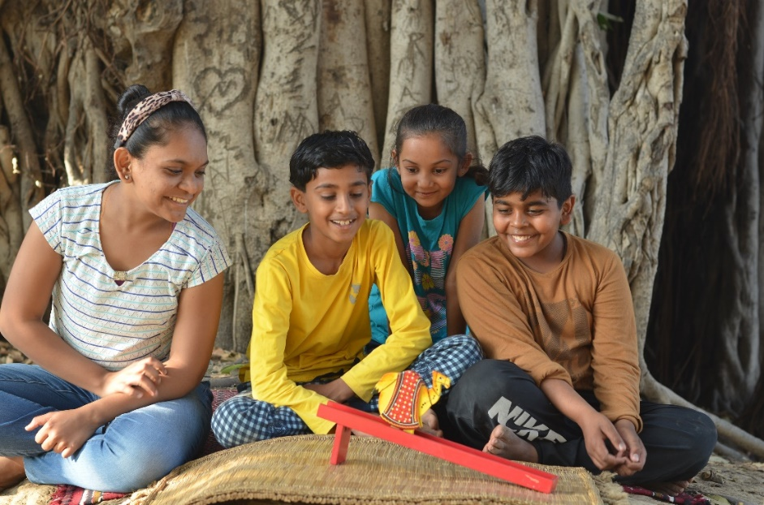

Slide 10
